Slide 1
Tensorflow !

Slide 2
What’s TensorFlow™?
● Open source software library for numerical computation using data flow graphs
● Originally developed by Google Brain Team to conduct machine learning and deep neural networks research
● General enough to be applicable in a wide variety of other domains as well TensorFlow provides an extensive suite of functions and classes that allow users to build various models from scratch.

Slide 3
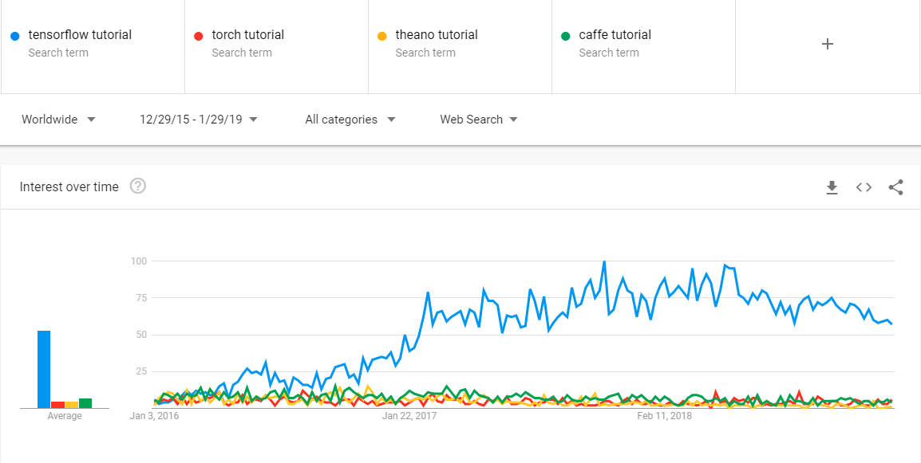
Why tensorflow ?

Slide 4
Why TensorFlow?
● Python API
● Portability: deploy computation to one or more CPUs or GPUs
● Flexibility: from Android, iOS, Windows, Linux to server farms
● Visualization (TensorBoard)
● Checkpoints (for managing experiments)
● Large community
● Because Google !

Slide 5
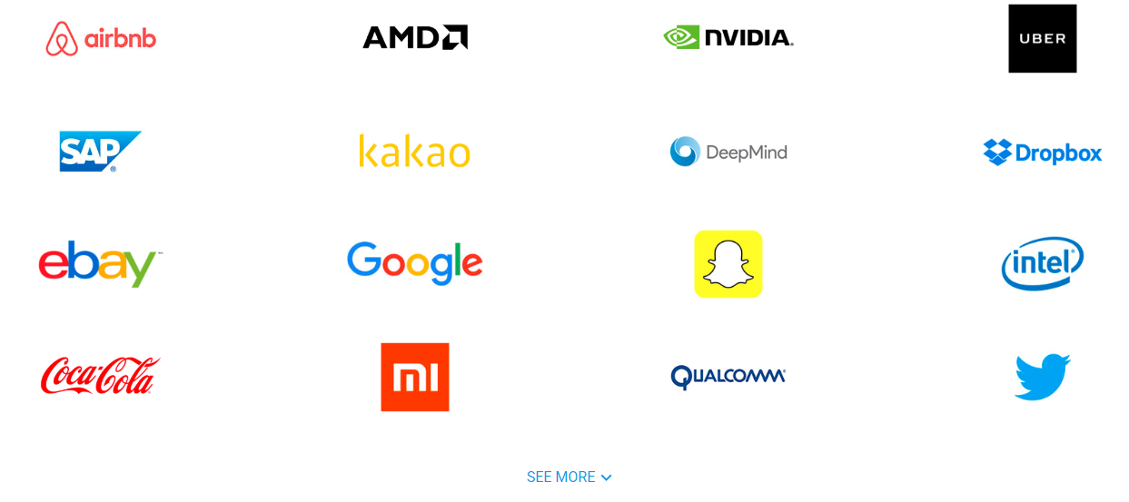
Companies using Tensorflow

